Slide 1
Title: Regularized Logistic Regression: Performance, Sparsity, And Feature Selection Subtitle: Experiments On Synthetic, Breast Cancer (Polynomial), And Digits Datasets Date: [Date]
Presentation by Abubakar Ahmad

Slide 2
Agenda
Motivation & Goals
Experiment 1: Synthetic High‑Dimensional Data (p >> n)
Experiment 2: Breast Cancer + Polynomial Features
Experiment 3: Digits Binary Classification
Cross‑Validation & Statistical Tests
Learning Curves, ROC, and Feature Importance
Summary & Key Takeaways

Slide 3
Why Regularization Matters
Problem: High‑dimensional data → overfitting, non‑interpretable models.
Solutions compared:
L2 (Ridge) – shrinks coefficients but no sparsity.
L1 (Lasso) – induces sparsity, feature selection.
ElasticNet – balances L1 and L2, handles correlated features.
Goal: Find best trade‑off between accuracy and sparsity.

Slide 4
Experiment 1 – Synthetic High‑Dimensional Data
Setup:
500 samples, 2000 features, 50 informative.
Train / test split (80/20), StandardScaler.
Key results:
Regularizer | Best C | Accuracy | Sparsity (# non‑zero coef)
L2 | 0.0001 | 0.66 | 1997
L1 | 0.1 | 0.65 | 152
ElasticNet 0.6 | 0.037 | 0.66 | 83
Observation:
L1 and ElasticNet reduce features from 2000 → 152 / 83 with almost no accuracy loss.

Slide 5
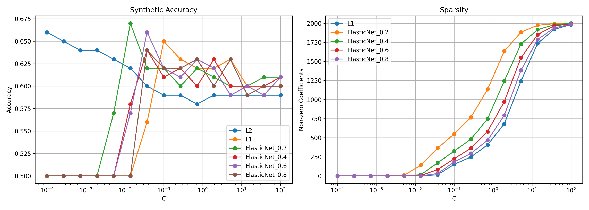

Slide 6
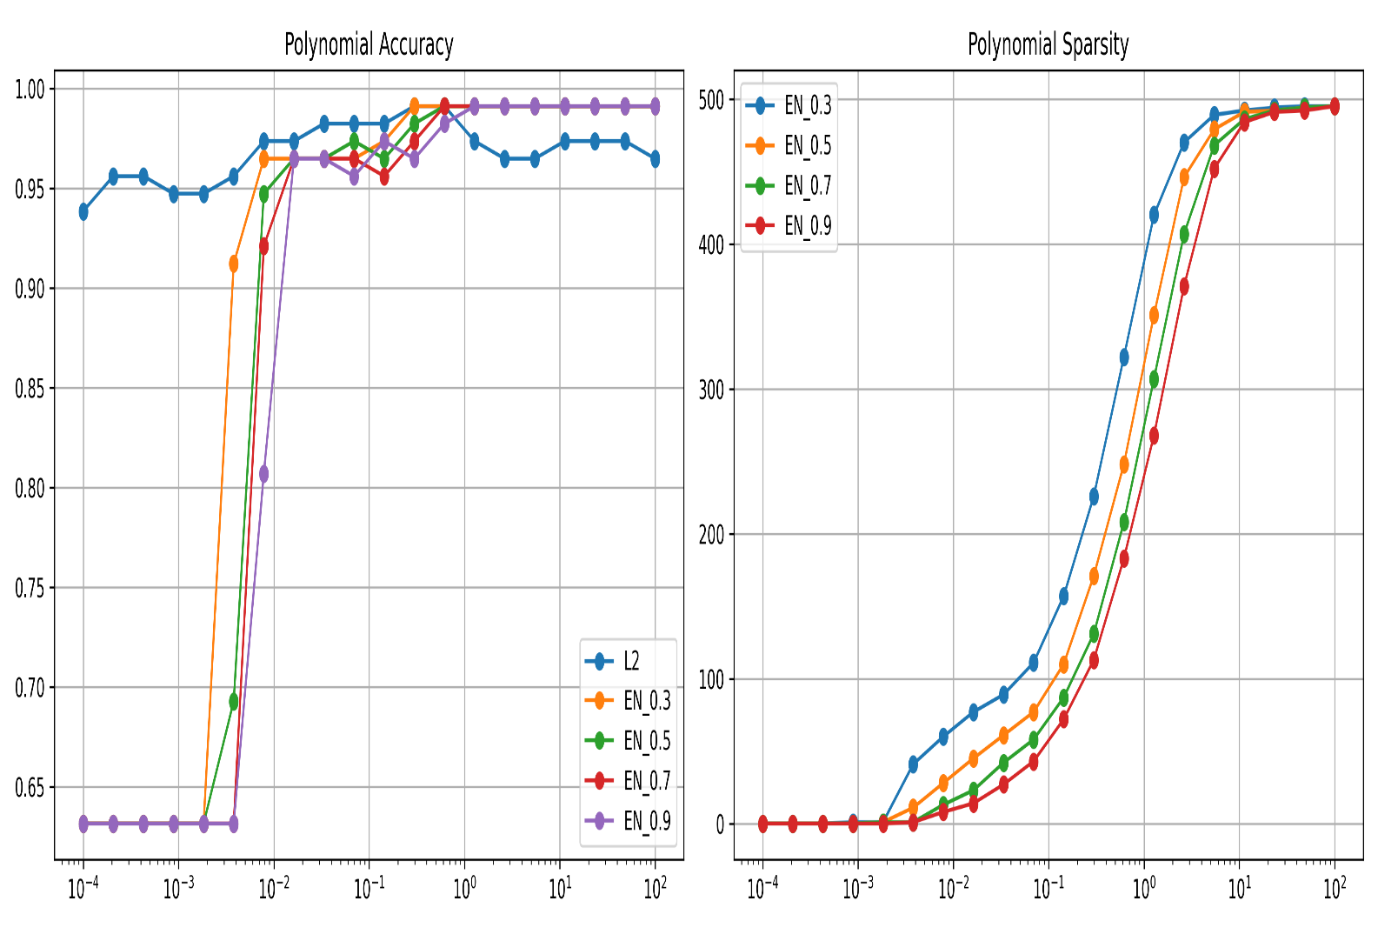
Experiment 2 – Breast Cancer + Polynomial Features
Motivation: Non‑linear effects → degree‑2 polynomial features.
Resulting feature count: ~5000 (dense, correlated).
Best test accuracy:
L2 → 0.96
ElasticNet (l1_ratio=0.3…0.9) → also 0.96 but with sparsity.
Sparsity behavior (right panel of figure):
L2 uses all features.
ElasticNet with higher l1_ratio drives many polynomial coefficients to zero.

Slide 7
Experiment 3 – Digits (3 vs. not‑3)
Binary classification (1797 images, 64 pixels).
Grid search results:
L1 (C≈2.64) → Acc = 0.9917, sparse (many zero coefficients).
ElasticNet (C≈1.93) → same accuracy, also sparse.
Dummy classifier (most frequent): ~0.90 accuracy → regularized models provide real gain.

Slide 8
Cross‑Validation & ANOVA
10‑fold stratified CV on Breast Cancer (no polynomial features).
Mean accuracy (L2, L1, ElasticNet) ≈ 0.97 – very close.
ANOVA p‑value → >0.05 → no statistically significant difference in CV scores.
Interpretation: All three regularizers perform equally well on low‑dimensional data. Regularization choice should then be based on sparsity / interpretability.

Slide 9
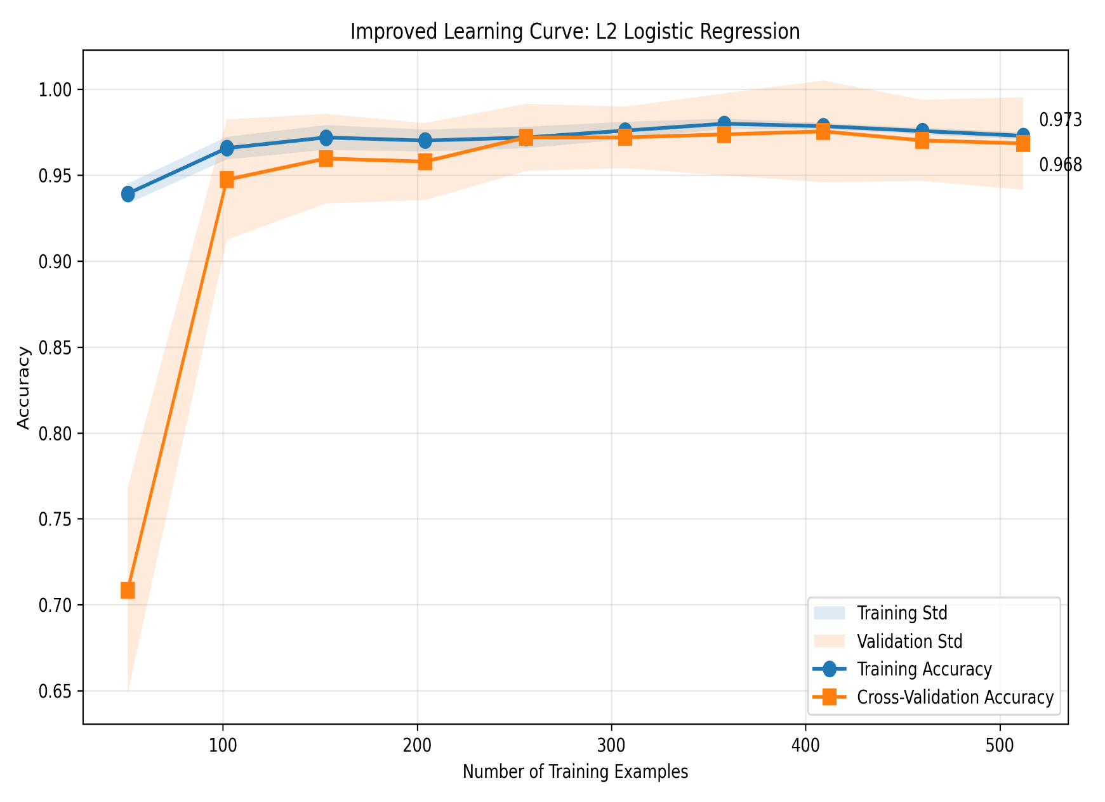
Learning Curve – L2 Logistic Regression
Key insights:
Training accuracy quickly reaches ~0.965.
Validation accuracy stabilises at ~0.96 after ≈200 samples.
No overfitting – training and validation curves converge.
Small gap → low bias & low variance.

Slide 10
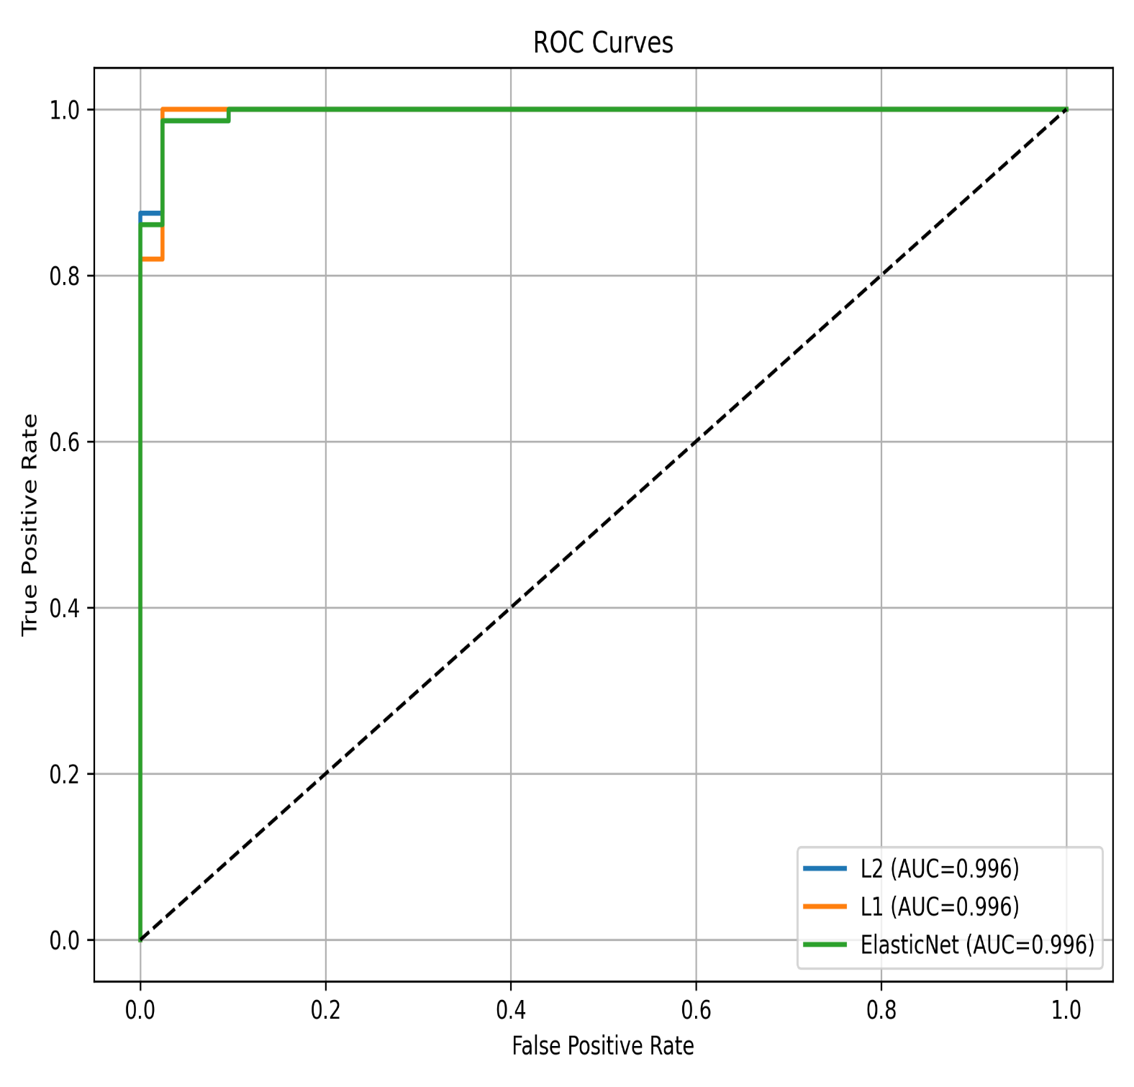
ROC Curves
Breast Cancer test set:
L2, L1, ElasticNet all achieve AUC = 0.996.
Almost perfect separability.
Conclusion: For this dataset, any regularizer works; choose based on non‑statistical
criteria (e.g. model simplicity).

Slide 11
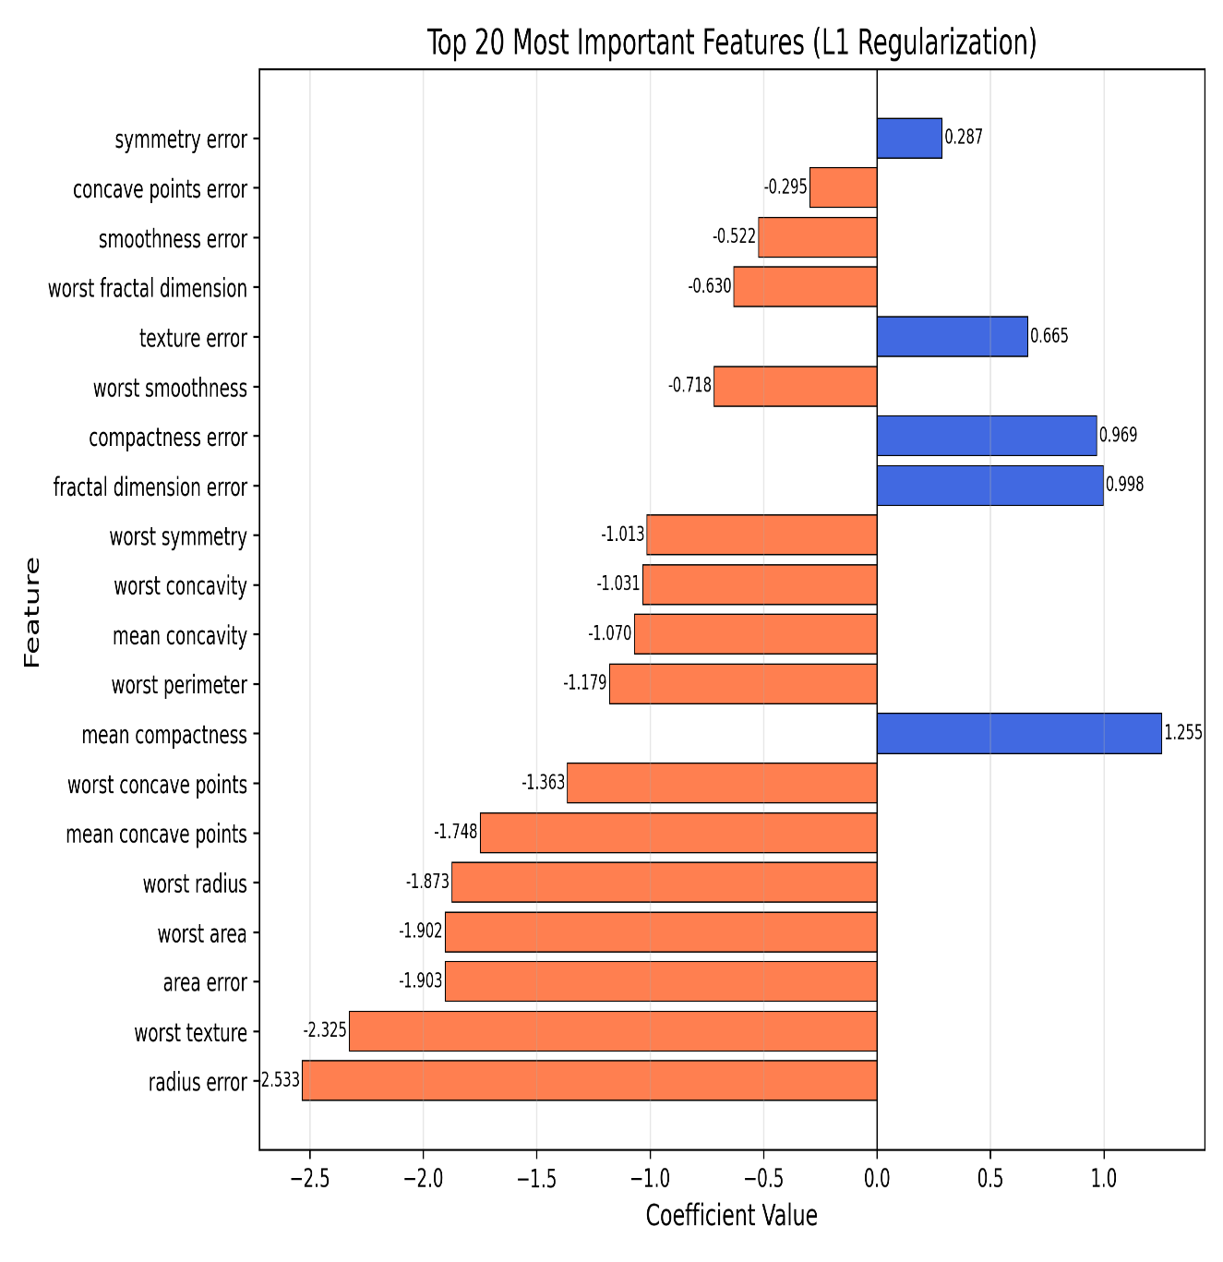

Feature Importance (L1 on Breast Cancer)
Top features by absolute coefficient (L1 model):
Positive influence: mean compactness, texture error, fractal dimension error
Negative influence: worst area, radius error, worst concave points
Why L1? It automatically selects the most discriminative features → easier to explain to clinicians.

Slide 12
Delivering with confidence
Summary of All Experiments
Dataset | Best Regularizer | Accuracy | Sparsity Achieved
Synthetic (p>>n) | ElasticNet (0.6) | 0.66 | 83 / 2000
Breast Cancer poly | L2 / EN | 0.96 | L2: none / EN: high
Digits | L1 / EN | 0.9917 | Yes (sparse)
Overall:
ElasticNet is most versatile – works well in high‑dim and polynomial cases.
L1 gives interpretable models when features are not too correlated.
L2 is safe but lacks feature selection.

Slide 13
Recommendations
Use L1 or ElasticNet when:
You need feature selection (p >> n or many polynomial terms).
Model interpretability is important.
Use L2 when:
All features are relevant (e.g. low‑dimensional, well‑designed).
You only care about prediction, not explanation.
Always perform:
Grid search over C (and l1_ratio for EN).
Cross‑validation & learning curves to diagnose overfitting.

Slide 14
Limitations & Future Work
Limitations:
Synthetic data only 500 samples – real high‑dim data may be noisier.
Polynomial experiment used degree 2 only.
Digits binarized (only “3” vs others) – multiclass extension possible.
Future directions:
Try SVM with RBF kernel on polynomial features.
Use Stability selection to confirm feature importance.
Extend to multinomial logistic regression (Digits 10 classes).

Slide 15
THANK YOU! QUESTIONS?

